Slide 1
Civil Society Restrictions and Autocratic Survival
Andrew Heiss
Duke University, Sanford School of Public Policy
ISA 2015

Slide 2
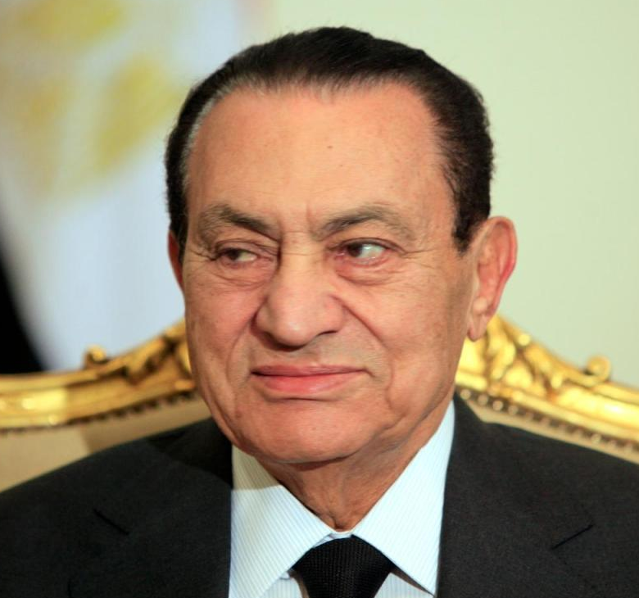
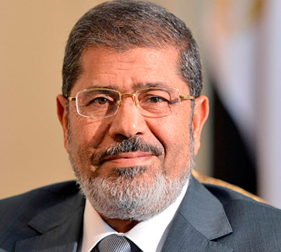
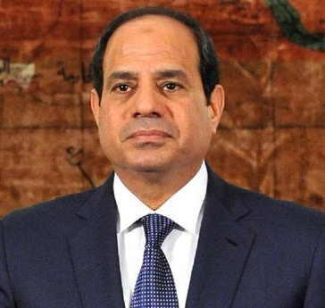
Attitudes towards civil society
Law 84/2002
Draft laws
Draft laws
Discretionary
Threats
Enforcement
Civil Society and Authoritarian Regimes | Theory | Results | So what?

Slide 3
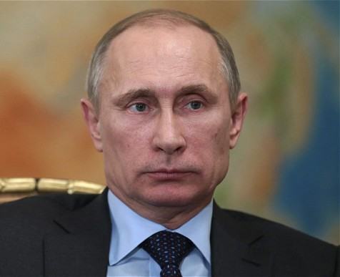
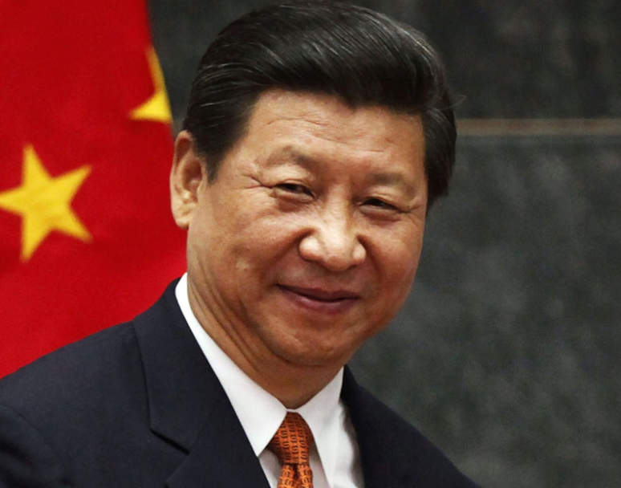
Other examples
Foreign crackdown
Consultative authoritarianism
Civil Society and Authoritarian Regimes | Theory | Results | So what?

Slide 4
Not used as intended
Competitive / hybrid / weird authoritarianism
Democratic-ish institutions in the service of regime stability
Parliaments
Protests
Election monitors
Civil Society and Authoritarian Regimes | Theory | Results | So what?

Slide 5
Institutional balancing
Civil Society and Authoritarian Regimes | Theory | Results | So what?
Notes:
Institutions = rules of the game
Reduce transaction costs

Slide 6
Helping the state
Associational life
Civic engagement
Government and social trust
Civil Society and Authoritarian Regimes | Theory | Results | So what?

Slide 7
Working against the state
Focal points
Social trust
Coordinated understanding
“Stand up to city hall”
Civil Society and Authoritarian Regimes | Theory | Results | So what?

Slide 8
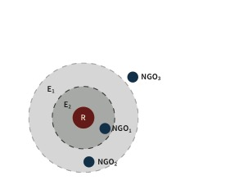
Watchdog space
Civil Society and Authoritarian Regimes | Theory | Results | So what?
Notes:
Formal model with no math, or formality ☹
NGOs and INGOs fall in some policy space in relation to the regime, which has its own preferences, allowable legal environment or advocacy space

Slide 9
Main question
When will authoritarian regimes contract or expand the legal environment for civil society?
Civil Society and Authoritarian Regimes | Theory | Results | So what?

Slide 10
Hypotheses
Stability
More restrictions when unstable
Competitiveness
Fewer restrictions when competitive
Civil Society and Authoritarian Regimes | Theory | Results | So what?
Notes:
Hypotheses - watchdog space will contract and expand based on the regime's competitiveness and stability - when more stable, it can allow for more dissonance. When less competitive, it'll feel less of a need to allow for dissonance

Slide 11
DV: Restrictions on freedom of assembly and association (CIRI)
Civil Society and Authoritarian Regimes | Theory | Results | So what?
Notes:
Testing this is tricky, though. There's no good measure of civil society restrictions - some recent work has tracked laws, and fancy event data methods like OED might get at de facto restrictions. But still not much.
I measure with HRD freedom of association and assembly. Not a perfect proxy at all, but it works

Slide 12
IV1: Stability
Government stability
Years exec. in office
Civil Society and Authoritarian Regimes | Theory | Results | So what?

Slide 13
IV2: Competitiveness
Years since election
Opposition vote share
Civil Society and Authoritarian Regimes | Theory | Results | So what?

Slide 14
Model results
Civil Society and Authoritarian Regimes | Theory | Results | So what?
Notes:
Ordered logistic regression models, increasing in complexity
For every year since a competitive election, the probability of improving civil society restrictions (i.e. moving from severely restricted to limited) decreases by nearly 6% (β = −0.06, z = −2.46, p = 0.014). Conversely, for every increase in the opposition vote share, the probability of being classified at a less restrictive level of associational life increases by 2.5% (β = 0.024, z = 2.85, p = 0.004), ceteris paribus.

Slide 15
Simulated competitiveness
Civil Society and Authoritarian Regimes | Theory | Results | So what?

Slide 16
Simulated stability
Civil Society and Authoritarian Regimes | Theory | Results | So what?

Slide 17
Hypotheses tested
Stability
Mostly no
More restrictions when unstable
Competitiveness
Yes, a little
Fewer restrictions when competitive
Civil Society and Authoritarian Regimes | Theory | Results | So what?

Slide 18
Anecdotal application
Stable
Unstable
Unstable
Competitive-ish
Competitive
Uncompetitive
Civil Society and Authoritarian Regimes | Theory | Results | So what?

Slide 19
So…
Less focus on intra-regime dynamics?
More focus on institutional interactions?
Civil Society and Authoritarian Regimes | Theory | Results | So what?

